Slide 1
CUDA at Scale for the Enterprise
Sorting Algorithm GPU Pseudocode

Slide 2
Canonical Sorting Algorithms
Bubble Sort
Radix Sort
Quick Sort

Slide 3

Bubble Sort Pseudocode
[1]

Slide 4
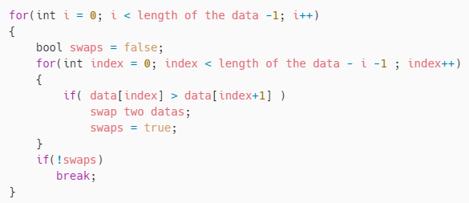
Bubble Sort Pseudocode
[1]

Slide 5
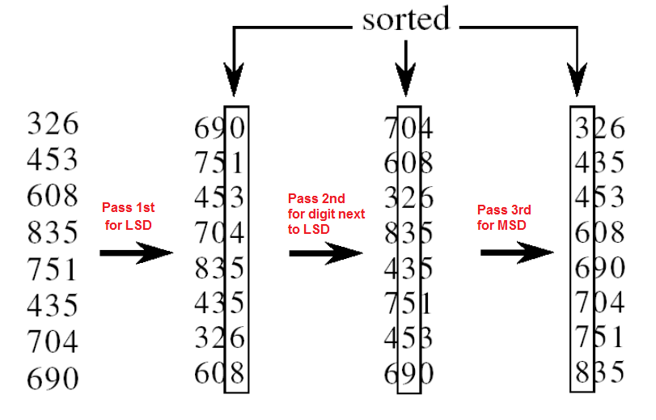
Radix Sort Pseudocode
[2]

Slide 6
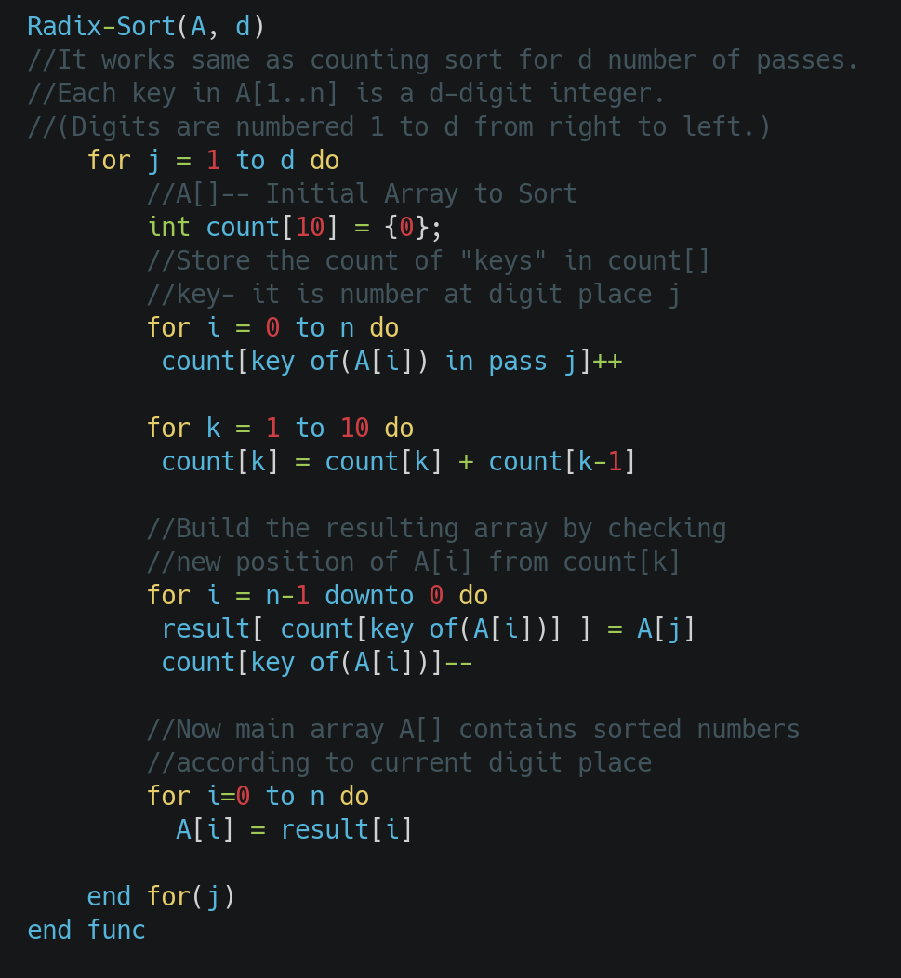
Radix Sort Pseudocode
[2]

Slide 7
Using Radix Sort for Non-integers
Strings – Characters in strings are actually numbers A=1 a=33, add special rules for ordering capitals vs lower-case vs special characters
Floats/Decimals – Not a perfect algorithm
Multiply and truncate (simpler but less accurate)
Use the string representation prepend/append 0’s to ensure all values are the same length (accurate but more complex)
Other more complex types – probably don’t use this

Slide 8
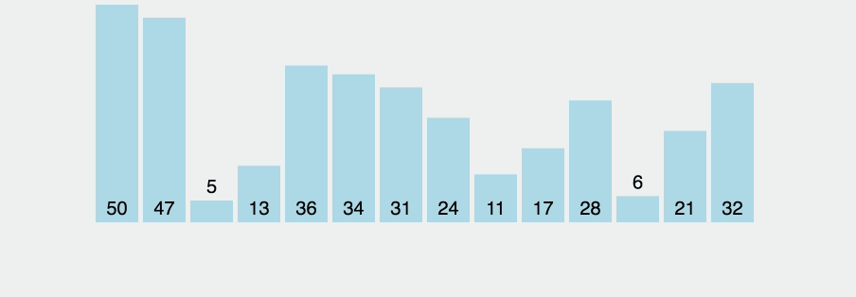
Quick Sort

Slide 9
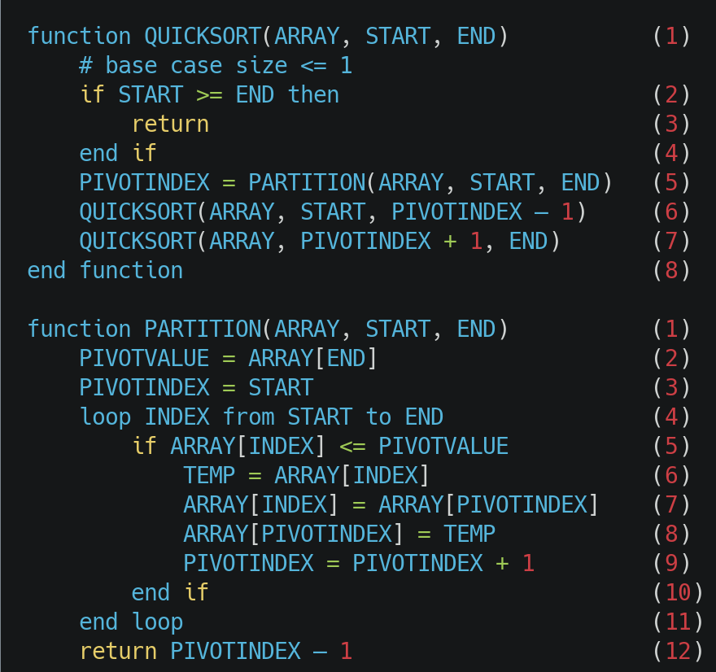
Quick Sort Pseudocode
[4]

Slide 10
References
[1] 2020. MG. Github. Algorithm - Bubble Sort ( Concept, Pseudocode and C++ code). Retrieved from https://mg729.github.io/algorithm/2020/03/01/Algorithm_(1)_BubbleSort/.
[2] 2017. Priyansh Mangal. Codingeek. Radix Sort – Explanation, Pseudocode and Implementation. Retrieved from https://www.codingeek.com/algorithms/radix-sort-explanation-pseudocode-and-implementation/ - 2_how_radix_sort_works.
[3] 2019. Yung L. Leung. Medium. An intro to advanced sorting algorithms: merge, quick & radix sort in JS. Retrieved from https://medium.com/free-code-camp/an-intro-to-advanced-sorting-algorithms-merge-quick-radix-sort-in-javascript-b65842194597.
[4] 2021. Kansas State University CS Dept. In CC310 Data Structures and Algorithms I. Retrieved from https://textbooks.cs.ksu.edu/cc310/7-searching-and-sorting/19-quicksort-pseudocode/.
NOTE: All pseudocode images were generated using carbon.now.sh

